Slide 1
MR CHOLANGIOPANCREATOGRAPHY: WHAT EVERY RADIOLOGY RESIDENT MUST KNOW
BRUNO P. C. VIDAL, MD ¹
DANIEL LAHAN-MARTINS, PhD ¹
THIAGO J. PENACHIM, MD ¹
MARCO ALEXANDRE M. RODSTEIN, MD ¹
PATRÍCIA P. CARDIA, PhD ¹
ADILSON PRANDO, MD ¹
¹ Department of Radiology and Imaging Diagnosis, Vera Cruz Hospital – Campinas Radiological Center, Campinas, SP, Brazil

Slide 2
¹ Department of Radiology and Imaging Diagnosis, Vera Cruz Hospital – Centro Radiológico Campinas, Campinas, SP, Brazil.
Corresponding author: D.L.M., dlahan@unicamp.br
Presented as an education exhibit during RSNA 2019 (GI282-ED-SUB9 - MR Cholangiopancreatography: What Every Radiology Resident Must Know).
There is no conflict of interest in this presentation.

Slide 3
LEARNING OBJECTIVES
AFTER REVIEWING THIS PRESENTATION SPECIALLY AIMED FOR RADIOLOGY RESIDENTS, TRAINEES AND THEIR TUTORS, THE LEARNER SHOULD BE ABLE TO:
  UNDERSTAND HOW MR CHOLANGIOPANCREATOGRAPHY (MRCP) IS PERFORMED, FOCUSING ON CURRENT TECHNIQUES, ADVANTAGES, ARTIFACTS, PITFALLS AND HOW TO AVOID THEM;
  DISCUSS THE INDICATIONS OF MRCP IN CORRELATION TO ENDOSCOPIC RETROGRADE CHOLANGIOPANCREATOGRAPHY (ERCP);
  ACCESS NORMAL / VARIANT BILIARY ANATOMY;
  IDENTIFY COMMON BILIARY PATHOLOGY SUCH AS STONES, BENIGN / MALIGNANT STRICTURES, LEAKS, IATROGENIC LESIONS AND OTHERS.

Slide 4
INTRODUCTION
MAGNETIC RESONANCE CHOLANGIOPANCREATOGRAPHY (MRCP) IS A WIDELY USED NON-INVASIVE METHOD IN THE EVALUATION OF PANCREATOBILIARY DISORDERS.
AS OPPOSED TO ENDOSCOPIC RETROGRADE CHOLANGIOPANCREATOGRAPHY (ERCP) IT ALLOWS EVALUATION OF BILIARY DUCTS BOTH UPSTREAM AND DOWNSTREAM TO INJURY, AS WELL AS EXTRA DUCTAL LESIONS, WHEN COMBINED WITH T1 AND T2 WEIGHTED IMAGES.
TECHNIQUE AND PROTOCOLS MAY VARY, BUT THERE ARE SOME KEY POINTS THAT EVERY RADIOLOGIST MUST KNOW IN ORDER TO PERFORM AND EXTRACT THE BEST OUT OF THIS METHOD.

Slide 5

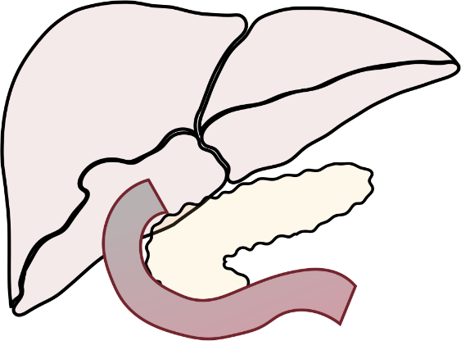
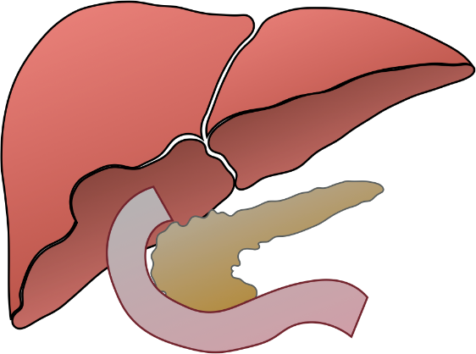
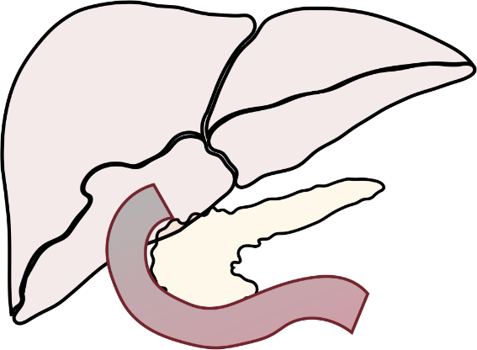






ERCP
MRCP
+ ADDITIONAL MRI SEQUENCES
?
?
DURING REGULAR ENDOSCOPIC RETROGRADE CHOLANGIOPANCREATOGRAPHY (ERCP), THE ENDOSCOPE IS INTRODUCED VIA ESOPHAGUS, PASSES THROUGH THE STOMACH AND REACHES THE DUODENAL PAPILLA, WHERE THE CONTRAST IS INJECTED INTO THE BILIARY TRACT.
WHEN ASSOCIATED WITH ADDITIONAL MRI SEQUENCES IT ALLOWS EXAMINATION OF EXTRADUCTAL LESIONS AS WELL AS ADJACENT STRUCTURES, CONTRIBUTING TO DIAGNOSIS.
EVEN THOUGH ERCP CAN BE THERAPEUTIC, IN CASE OF EXTRINSIC OBSTRUCTION, THE CONTRAST AGENT STOPS AT THAT POINT AND THE UPSTREAM BILIARY TRACT CANNOT BE EXAMINED.
MAGNETIC RESONANCE CHOLANGIOPANCERATOGRAPHY (MRCP) ALLOWS EVALUATION OF BILIARY DUCTS BOTH UPSTREAM AND DOWNSTREAM TO INJURY.

Slide 6
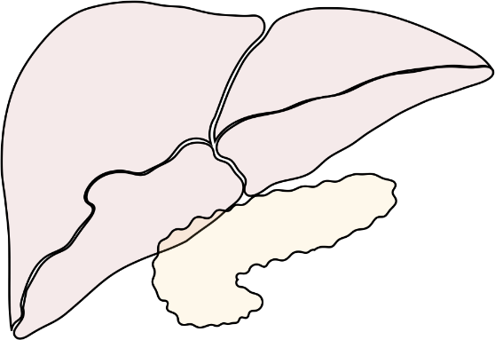
BILIARY ANATOMY
THE BILIARY DRAINAGE SYSTEM RUNS PARALLEL TO THE PORTAL VENOUS SYSTEM; THEREFORE THEY ARE BOTH VERY SIMILAR.
RIGHT HEPATIC
DUCT (RHD)
LEFT HEPATIC
DUCT (LHD)
RIGHT ANTERIOR
BRANCH (RA)
LEFT MEDIAL BRANCH (LM)
THE BILE DUCTS CAN BE CLASSIFIED INTO:
RIGHT POSTERIOR
BRANCH (RP)
LEFT LATERAL BRANCH (LL)
1ST ORDER BILE DUCTS
COMMON HEPATIC DUCT (CHD)
2ND ORDER BILE DUCTS
CYSTIC
DUCT (C)
3RD ORDER BILE DUCTS (SMALL INTRA-HEPATIC BRANCHES)
COMMON BILE DUCT
PORTAL VENOUS SYSTEM

Slide 7
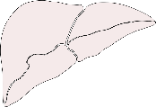
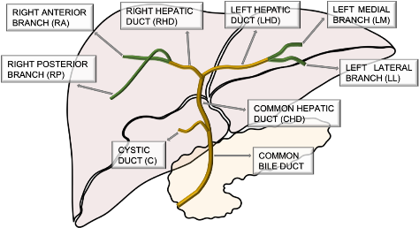
ANATOMIC VARIATIONS
TYPE I: (RP) DUCT JOINING (RA) MEDIALLY TO FORM (RHD)
TYPE III-C: ANOMALOUS DRAINAGE OF (RP), JOINING CYSTIC DUCT
BRANCHING PATTERNS OF THE RIGHT HEPATIC BILE DUCT:
TYPICAL BILIARY ANATOMY (TYPE I)
TYPE II: TRICONFLUENCE – SIMULTANEOUS EMPTYING OF THE (RA), (RP) AND (LHD) INTO THE (CHD)
TYPE IV: ABERRANT DRAINAGE OF (RHD) INTO THE CYSTIC DUCT
TYPE III-A: ANOMALOUS DRAINAGE OF (RP), JOINING (LHD) – CROSSOVER ANOMALY
TYPE V: ACCESSORY RIGHT HEPATIC DUCT
TYPE VI: SEGMENTS II AND III DUCT DRAINING INDIVIDUALLY INTO THE (RHD) OR (CHD)
TYPE III-B: ANOMALOUS DRAINAGE OF (RP), JOINING (CHD)
TYPE VII: OTHERS AND UNCLASSIFIED VARIATIONS

Slide 8
ANATOMIC VARIATIONS
BRANCHING PATTERNS OF THE RIGHT HEPATIC BILE DUCT
TYPE II: TRICONFLUENCE (RED CIRCLE) – SIMULTANEOUS EMPTYING OF THE (RA), (RP) AND (LHD) INTO THE (CHD)
TYPE III-B: ANOMALOUS
DRAINAGE OF (RP), JOINING COMMON HEPATIC DUCT (RED CIRCLE)
TYPE III-C: ANOMALOUS DRAINAGE OF (RP), JOINING CYSTIC DUCT (RED CIRCLE)

Slide 9
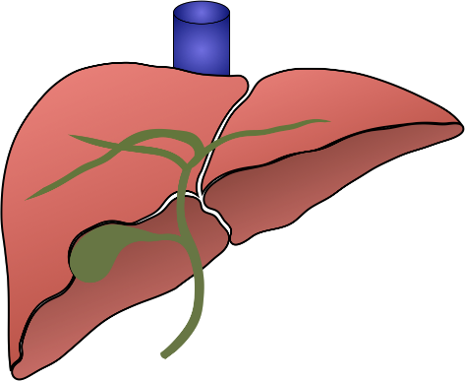


ANATOMIC VARIATIONS
BRANCHING PATTERNS OF THE RIGHT HEPATIC BILE DUCT
TYPE III-A: ANOMALOUS DRAINAGE OF (RP), JOINING (LHD) – CROSSOVER ANOMALY (RED CIRCLE)
!
BE AWARE
IN CASE OF LEFT HEPATECTOMY, THERE COULD BE AN IATROGENIC LESION DUE TO THE FACT THAT RESSECTION ALONG THE CANTLIE’S LINE (HEPATECTOMY PLANE) WILL TEAR THE RPD
CANTLIE’S
LINE

Slide 10
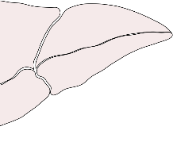
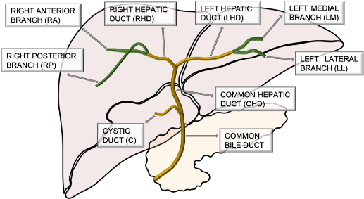
ANATOMIC VARIATIONS
BRANCHING PATTERNS OF THE LEFT HEPATIC BILE DUCT:
TYPE A: COMMON TRUNK OF SEGMENT II AND III JOINS SEGMENT IV
LEFT HEPATIC
DUCT (LHD)
TYPICAL BILIARY ANATOMY
TYPE B: TRICONFLUENCE
OF SEGMENTS II, III AND IV
LEFT HEPATIC
DUCT (LHD)
TYPE C: SEGMENT II DUCT DRAINS INTO
COMMON TRUNK OF SEGMENT III AND SEGMENT IV
LEFT HEPATIC
DUCT (LHD)
TYPE D: OTHERS AND UNCLASSIFIED VARIATIONS

Slide 11
ANATOMIC VARIATIONS
COMMON AND UNCOMMON VARIATIONS OF THE GALLBLADDER AND CYSTIC DUCT:
TYPICAL BILIARY ANATOMY
RIGHT LATERAL INSERTION
ANTERIOR / POSTERIOR SPIRAL INSERTION
PROXIMAL
INSERTION
LOW MEDIAL INSERTION
DOUBLE CYSTIC DUCT
CHOLECYSTOHEPATIC DUCT
ABSENT CYSTIC DUCT
DOUBLE GALLBLADDER

Slide 12
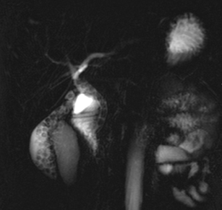
ANATOMIC VARIATIONS
COMMON AND UNCOMMON VARIATIONS OF THE GALLBLADDER AND CYSTIC DUCT
LOW MEDIAL INSERTION
(RED CIRCLE)
POSTERIOR SPIRAL INSERTION (RED ARROWHEADS)
DOUBLE GALLBLADDER
(RED ARROWHEADS)

Slide 13

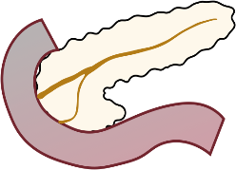
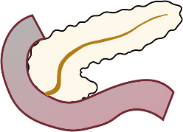




ANATOMIC VARIATIONS
VARIATIONS IN CONFIGURATION OF THE PANCREATIC DUCT:
COMMON BILE DUCT
DORSAL PANCREATIC DUCT (SANTORINI)
BIFID CONFIGURATION WITH DOMINANT DORSAL PANCREATIC DUCT DRAINAGE WITHOUT DIVISUM
RUDIMENTARY NON-DRAINING DORSAL PANCREATIC DUCT
VENTRAL PANCREATIC DUCT (WIRSUNG)
MINOR PAPILLA
DUODENUM
MAJOR PAPILLA
BIFID CONFIGURATION WITH DOMINANT DUCT OF WIRSUNG DRAINAGE WITHOUT DIVISUM
PANCREAS DIVISUM
ANSA PANCREATICA

Slide 14
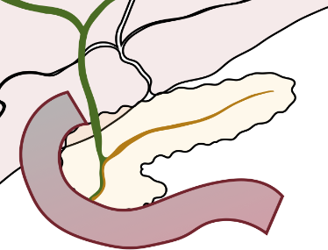




ANATOMIC VARIATIONS
ANOMALOUS PANCREATOBILIARY JUNCTION (APBJ):
VARIATIONS IN COURSE OF THE PANCREATIC DUCT:
BP TYPE
LONG PANCREATOBILIARY COMMON DUCT ( > 1,5cm )
DESCENDING COURSE
VERTICAL COURSE
BILIARY COMMON DUCT DRAINING INTO MAIN PANCREATIC DUCT (RED ARROWHEAD)
PB TYPE
RISK FACTOR FOR:
ACUTE PANCREATITIS
CHOLANGITIS
CHOLEDOCHAL CYSTS
BILIARY TREE NEOPLASIA (including gallbladder)
SIGMOID COURSE
LOOP SHAPED COURSE
MAIN PANCREATIC DUCT DRAINING INTO BILIARY COMMON DUCT (RED ARROWHEAD)

Slide 15



ANATOMIC VARIATIONS
PANCREAS
DIVISUM (RED ARROWHEADS)
LOOP SHAPED
COURSE (RED ARROWHEADS)

Slide 16


WHEN TO DO MRCP?
CHOLESTASIS OR CHOLESTATIC SYNDROME
EVALUATION OF
BILIARY ANATOMIC VARIATIONS
PREOPERATIVE
OF HEPATIC RESECTION
BILIARY POSTOPERATIVE EVALUATION
DIAGNOSIS AND EVALUATION OF PSC
PANCREATITIS OF
UNKNOWN ETIOLOGY
UNSUCCESSFUL ERCP OR CONTRAINDICATION
BILIARY-ENTERIC ANASTOMOSIS (BILROTH II and CHOLEDOCHOJEJUNOSTOMY)
ADVANTAGES VS. DISADVANTAGES
NONINVASIVE
PROCEDURE
DOES NOT USE IONIZING RADIATION
EXPENSIVE (WHEN COMPARED TO ULTRASOUND)
LESS OPERATOR DEPENDENT THAN
ULTRASOUND AND ERCP
REQUIRES PATIENT’S COOPERATION
(BREATH HOLD – STAY STILL)
ALLOWS DETECTION OF EXTRADUCTAL DISEASE (WHEN COMBINED WITH T1 AND T2 WEIGHTED IMAGES)
INABILITY TO INTERVENE / BIOPSY (WHEN COMPARED TO ERCP)
POORER SPATIAL RESOLUTION / DEFINITION (WHEN COMPARED
TO ERCP)

Slide 17

TECHNIQUE & PROTOCOLS
MRPC IS BASED ON HEAVILY
T2-WEIGHTED SEQUENCES
STATIONARY FLUID-FILLED STRUCTURES’ SIGNAL IS GREATLY INCREASED
RESULTING IN INCREASED DUCT-TO-BACKGROUND CONTRAST
TWO-DIMENSIONAL (2D) RADIAL
CHOLANGIO (THREE-DIMENSIONAL) 3D
POSTSECRETIN ADMINISTRATION ACQUISITION MRCP (S-MRCP)
BREATH-HOLD
RESPIRATORY TRIGGERING
IV SECRETIN STIMULATES PANCREATIC SECRETION
5-8 SLICES (40 mm)
SINGLE VOLUME ACQUISITION
(THIN SLICES)
ALLOWS FOR BETTER VISUALIZATION OF PANCREATIC DUCTS
GUIDE FOR THIN SLAB ACQUISITIONS
3-5 MINUTES ACQUISITION TIME
FINE DETAILS OF BD/PD
ALLOWS MPR AND 3D REFORMATTING
REDUCES FLUID SECRETION WITHIN THE STOMACH AND DUODENUM
ANTICHOLINERGIC / ANTISPASMODIC DRUGS CAN BE USED AS WELL
4-6 HOUR FASTING IS REQUIRED PRIOR TO THE STUDY
REDUCES BOWEL PERISTALSIS
PROMOTES GALLBLADDER DISTENSION

Slide 18
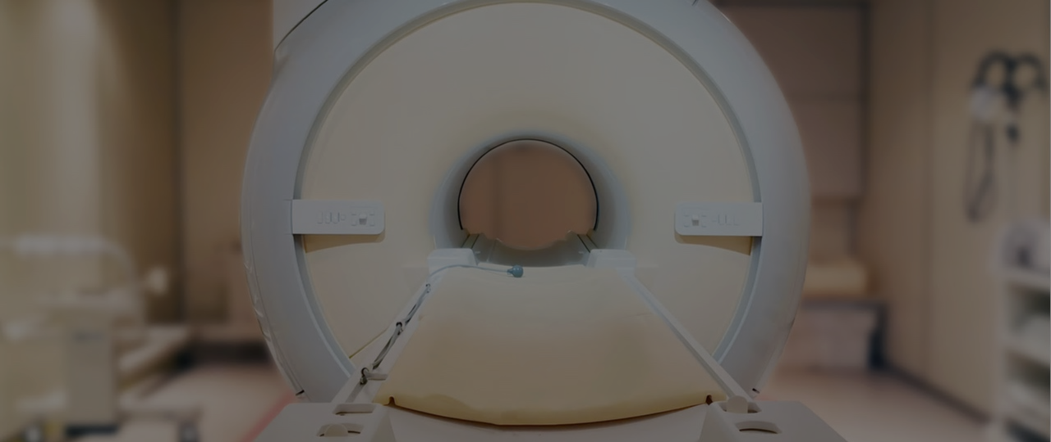

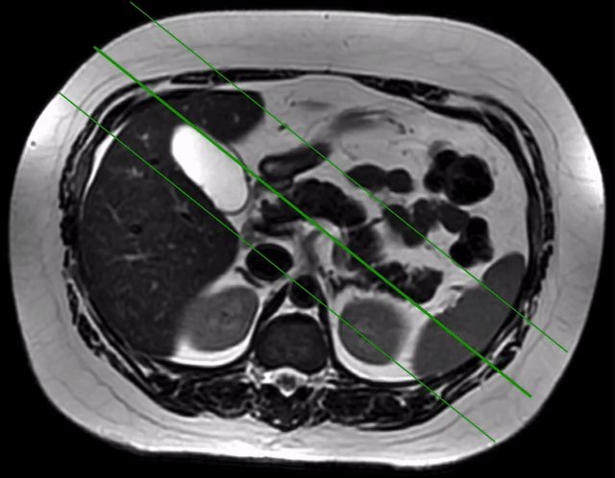
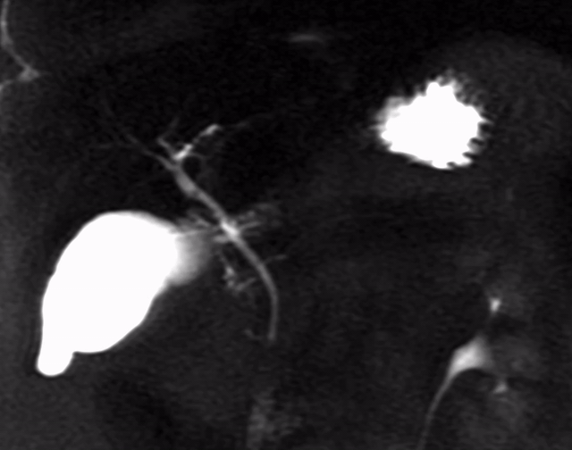
TECHNIQUE & PROTOCOLS
2D RADIAL
BREATH-HOLD
5-8 SLICES (40 mm)
GUIDE FOR THIN SLAB ACQUISITIONS
FINE DETAILS OF BD/PD

Slide 19
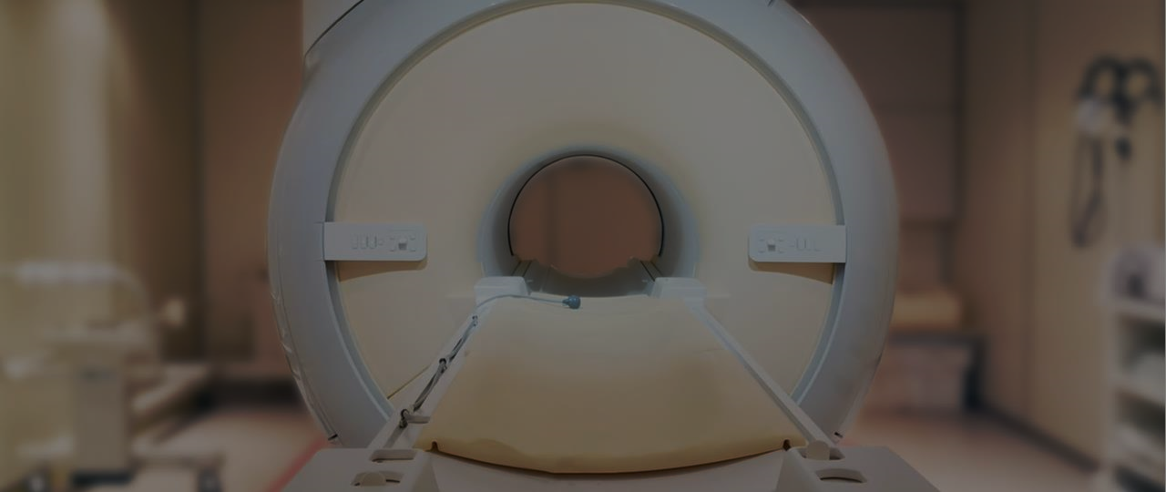
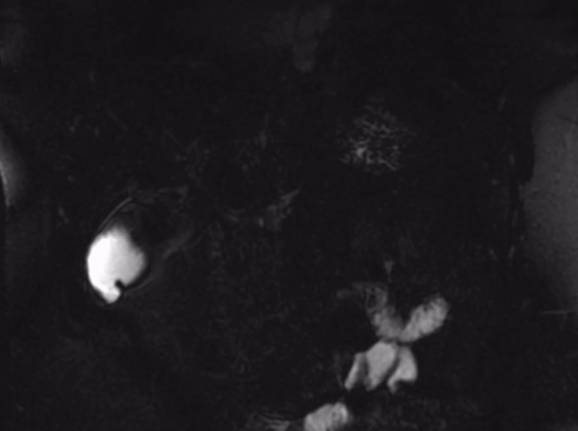
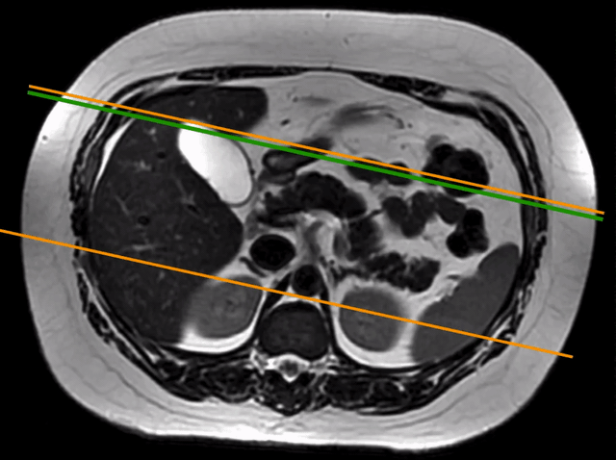
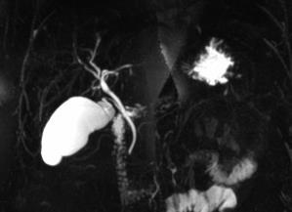
TECHNIQUE & PROTOCOLS
CHOLANGIO 3D
RESPIRATORY TRIGGERING
SINGLE VOLUME ACQUISITION (THIN SLICES)
3-4 MINUTES ACQUISITION TIME
ALLOWS MPR AND 3D REFORMATTING

Slide 20
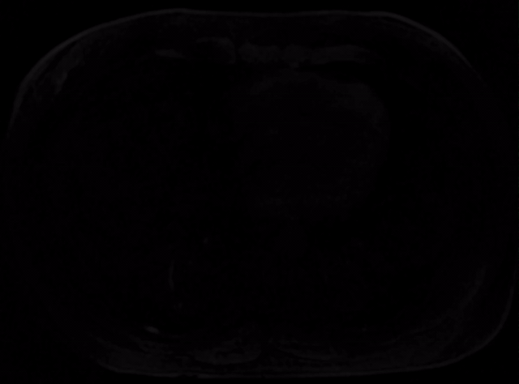
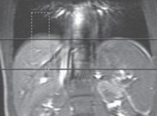
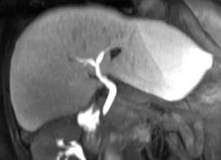
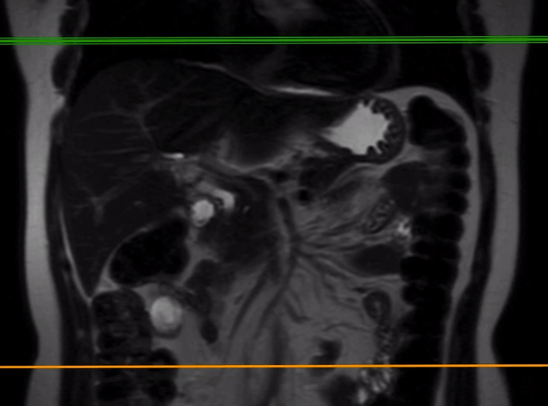
TECHNIQUE & PROTOCOLS
CE-MRC
(ACTIVE MRC)
HEPATOSPECIFIC PARAMAGNETIC GADOLINIUM-BASED CONTRAST MEDIA
BRIGHT BILE ON T1 WEIGHTED IMAGES SINCE THE CONTRAST IS EXCRETED IN THE BILE DUCTS
HIGH-RESOLUTION / VOLUME T1

Slide 21
WHEN TO ADD OTHER MRI SEQUENCES?
MRCP SEQUENCES (HEAVILY T2WI TO EVALUATE BILIARY DUCTS, GALLBLADDER AND PANCREATIC DUCT) CAN EVENTUALLY BE COMPLEMENTED WITH ADDITIONAL DIRECTED MRI SEQUENCES (T1 AND T2 WI) AS WELL AS THE USE OF ENDOVENOUS PARAMAGNETIC CONTRAST ADMINISTRATION, DEPENDING ON CLINICAL INDICATION OR IMAGING FINDINGS.
SUSPECTED OR CONFIRMED NEOPLASIA
TO BETTER EVALUATE INFECTIONS
TO BETTER EVALUATE PANCREATITIS
ANALYZING PATHOLOGIES NOT RELATED TO BILE DUCTS
PANCREAS
CHOLANGITIS
DIFFERENTIATING EDEMATOUS FROM NECROTIZING
INCIDENTAL PATHOLOGIES IN UPPER ABDOMEN
GALLBLADDER
ABSCESS
BILIARY DUCTS
EVALUATE COMPLICATIONS

Slide 22
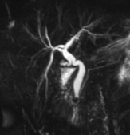
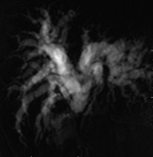
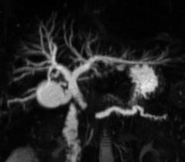
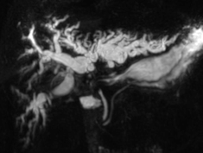
A GLANCE AT PATHOLOGY
OBSTRUCTION PATTERNS RELATED TO BILIARY TRACT DISEASES
BENIGN
MALIGNANT
USUALLY ABRUPT, REGULAR AND SMOOTH SHAPED OBSTRUCTIONS
USUALLY ASYMMETRIC, LONG AND IRREGULAR SHAPED OBSTRUCTIONS
CALCULI TYPICALLY PRODUCE INTRALUMINAL ROUNDED FILLING DEFECTS OR MENISCUS-SHAPED LUMEN TERMINATION
CONCOMITANT DILATED BILIARY AND PANCREATIC DUCT (WHEN DISTAL LESION)
EXTRINSIC INFLAMMATORY DISEASE (CHRONIC CHOLECYSTITIS, PANCREATITIS) USUALLY PRODUCES A ROUNDED COMPRESSION OF THE ADJACENT BILE DUCT
POSTOPERATIVE FIBROTIC STRICTURES USUALLY APPEAR AS A SHORT, FOCAL STRICTURE OR SHORT SEGMENTAL DUCT OCCLUSION

Slide 23
A GLANCE AT PATHOLOGY
CHOLEDOCHOLITHIASIS (MOST COMMOM)
OBSTRUCTION
ACUTE CHOLANGITIS
INFECTION
BENIGN
PRIMARY SCLEROSING CHOLANGITIS
INFLAMMATORY
DISEASES RELATED TO BILIARY TRACT
CONGENITAL
BILIARY ATRESIA
IATROGENIC / TRAUMATIC
POST SURGERY BILE LEAKS / OBSTRUCTION OR BILOMAS
CHOLANGIOCARCINOMA
MALIGNANT
NEOPLASIA
AMPULLARY CARCINOMA
PANCREATIC HEAD ADENOCARCINOMA
GALLBLADDER CARCINOMA

Slide 24
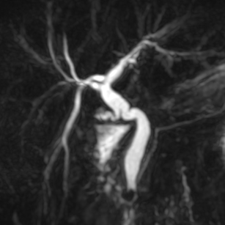
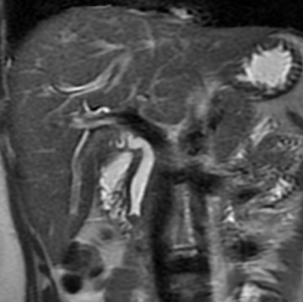
A GLANCE AT PATHOLOGY
DISEASES RELATED TO BILIARY TRACT
BENIGN
OBSTRUCTION
CHOLEDOCHOLITHIASIS
STONES OR CALCULI IN THE COMMON BILE DUCT
MRCP HAS HIGH SENSITIVITY (81-100%) AND SPECIFICITY (85-100%)
MRCP 3D
T2 WI
MRCP 3D
T2 WI
BILE: VERY BRIGHT SIGNAL
DUCTAL STONE: LOW-INTENSITY SIGNAL FOCI (RED ARROWHEADS)
BILIARY “STEINSTRASSE” (RED ARROWHEADS)
CALCULI TYPICALLY PRODUCE INTRALUMINAL ROUNDED FILLING DEFECTS OR MENISCUS-SHAPED LUMEN TERMINATION

Slide 25
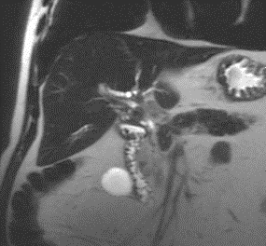
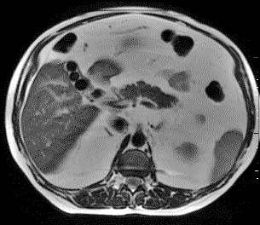
A GLANCE AT PATHOLOGY
DISEASES RELATED TO BILIARY TRACT
BENIGN
OBSTRUCTION
MIRIZZI SYNDROME
EXTRINSIC COMPRESSION OF AN EXTRAHEPATIC BILIARY DUCT FROM ONE OR MORE CALCULI WITHIN THE CYSTIC DUCT OR GALLBLADDER
MRCP 3D
CORONAL T2 WI
AXIAL T2 WI
CONTRACTED GALLBLADDER WITH MULTIPLE CALCULI (RED ARROWHEADS). ONE OF THEM, LOCATED IN THE INFUNDIBULUM / CYSTIC DUCT (BLUE ARROWHEADS), DETERMINES EXTRINSIC COMPRESSION OF THE COMMON HEPATIC DUCT, AND CONSEQUENT MODERATE UPSTREAM BILE DUCTS DILATATION.

Slide 26
A GLANCE AT PATHOLOGY
DISEASES RELATED TO BILIARY TRACT
BENIGN
INFECTION
BACTERIAL ACUTE CHOLANGITIS
INFLAMMATION OF INTRA/EXTRAHEPATIC BILE DUCT WALLS, USUALLY DUE TO DUCTAL OBSTRUCTION AND INFECTION
T1WI PRE-GD
ARTERIAL
PORTAL
EQUILIBRIUM
DISTAL CHOLEDOCHOLITHIASIS WITH SIGNS OF ACUTE CHOLANGITIS. NOTE THAT THE FILLING DEFECT IN DISTAL CBD (RED ARROWHEAD) CAUSES BILIARY DILATATION. TRANSIENT PERFUSIONAL DISORDER (BLUE ARROWHEADS) AND BILIARY DUCT WALL THICKENING (GREEN ARROWHEAD) LEAD TO CHOLANGITIS DIAGNOSIS.
PARENCHYMAL AND BILIARY CHANGES CAN ALSO BE SEEN IN THIS CASE, AS WELL AS INTRA-HEPATIC ABSCESS (RED ARROWHEADS) AS A COMPLICATION OF ACUTE BACTERIAL CHOLANGITIS.

Slide 27
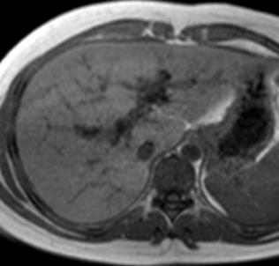
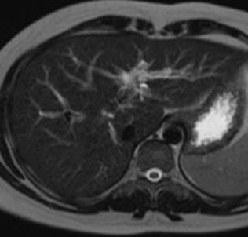
A GLANCE AT PATHOLOGY
DISEASES RELATED TO BILIARY TRACT
BENIGN
INFLAMMATORY
PRIMARY SCLEROSING CHOLANGITIS (PSC)
CHRONIC IDIOPATHIC INFLAMMATORY PROCESS OF BILE DUCTS
MIP REFORMATTED 3D MRCP IMAGE OF A PSC CASE SHOWING IRREGULAR STRICTURES WITH SEGMENTAL DILATATIONS (RED ARROWHEADS) OF INTRA-HEPATIC BILE DUCTS
OTHER MRI FINDINGS OF PSC INCLUDE LOW SIGNAL INTENSITY ALONG BILE DUCTS & PORTAL VEINS ON T1WI (RED ARROWHEADS), AS WELL AS HIGH SIGNAL INTENSITY OF THESE STRUCTURES ON T2WI, MEANING PERIPORTAL FIBROSIS (BLUE ARROWHEADS).

Slide 28
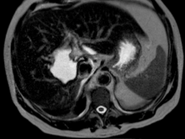
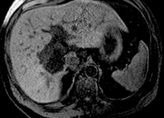
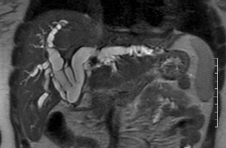
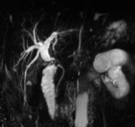
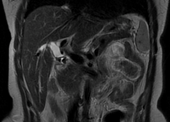
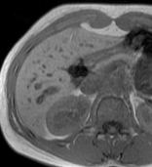
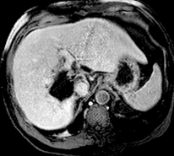
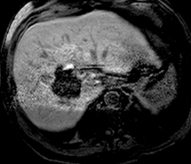
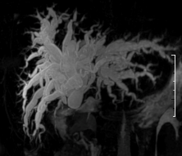
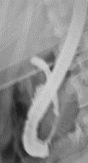
A GLANCE AT PATHOLOGY
DISEASES RELATED TO BILIARY TRACT
BENIGN
IATROGENIC / TRAUMATIC
POST SURGERY BILE LEAKS / OBSTRUCTION OR BILOMAS
IATROGENIC / TRAUMATIC LESIONS INVOLVING THE BILIARY TREE CAN LEAD TO BILE LEAKAGE, BILOMAS, STRICTURES, BILIARY TREE OBSTRUCTION, VARIOUS TYPES OF BILIARY FISTULAS, AND HEMOBILIA.
T2WI
BILOMA
T1WI PRE-GD
IATROGENIC DISTAL CBD LIGATURE
CHOLECYSTECTOMY METALLIC CLIP CAUSING INTRAHEPATIC BILE DUCT DILATATION
MRCP
T2WI
T1WI-GRE
T2WI
OBSERVE THAT THE CHOLECYSTECTOMY METALLIC CLIP, ALONG WITH FIBROSIS AND POSSIBLE THERMIC LESIONS SECONDARY TO THE PROCEDURE, CAUSES PARTIAL OBSTRUCTION OF CBD (RED ARROWHEADS) WITH INTRA-HEPATIC BILE DUCTS DILATATION. T1WI-GRE SHOWS MAGNETIC SUSCEPTIBILITY ARTIFACT DUE TO THE METALLIC CLIP (BLUE ARROWHEAD).
MRCP
ERCP
VENOUS
HEPATOBILIARY
AXIAL MR IMAGES SHOWING A BILOMA. NOTE THAT ON HEPATOBILIARY PHASE THERE IS A BILE LEAK (RED ARROWHEAD) TO THE BILOMA CAVITY.
NOTE THAT THERE IS ABRUPT INTERRUPTION OF THE COMMON HEPATIC BILE DUCT (RED ARROWHEADS) WITH INTRA-HEPATIC BILE DUCTS DILATATION. THIS WAS CONFIRMED WITH ERCP WHERE THE CONTRAST ONLY OPACIFIED THE DISTAL CBD (BLUE ARROWHEAD).

Slide 29
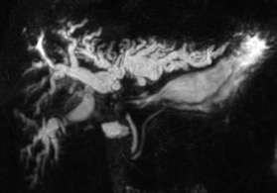
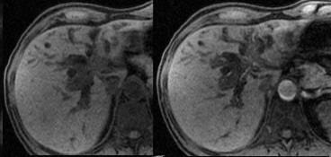
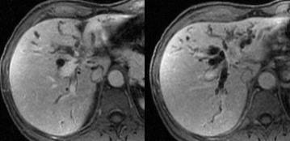
A GLANCE AT PATHOLOGY
DISEASES RELATED TO BILIARY TRACT
MALIGNANT
NEOPLASIA
CHOLANGIOCARCINOMA
MALIGNANCY THAT ARISES FROM INTRAHEPATIC BILE DUCT (IHBD) OR EXTRAHEPATIC BILE DUCT EPITHELIUM
3D-MRCP
T1WI
PRE-GD
ARTERIAL
PORTAL
EQUILIBRIUM
3D-MRCP DEMONSTRATES THE LONGITUDINAL EXTENT OF THE TUMOR ALONG THE COMMON BILE DUCT AND CONFLUENCE, EXTENDING TO RIGHT AND LEFT HEPATIC BILE DUCTS (RED CIRCLE), WITH MARKED INTRA-HEPATIC BILIARY DILATATION. AXIAL UNENHANCED T1-W, TOGETHER WITH MR IMAGES OBTAINED IN THE ARTERIAL PHASE, PORTAL VENOUS PHASE, AND EQUILIBRIUM PHASE, DEMONSTRATES INFILTRATIVE PERI-HILAR TUMOR (RED ARROWHEADS) WITH PROGRESSIVE ENHANCEMENT.

Slide 30
A GLANCE AT PATHOLOGY
DISEASES RELATED TO BILIARY TRACT
MALIGNANT
NEOPLASIA
PANCREATIC HEAD ADENOCARCINOMA
MALIGNANCY THAT ARISES FROM DUCTAL EPITHELIUM OF EXOCRINE PANCREAS
MRCP
T2WI
DWI
MRCP IMAGE SHOWING DILATED INTRA AND EXTRA-HEPATIC BILE DUCTS AS WELL AS THE MAIN PANCREATIC DUCT WITH ABRUPT DISTAL OBSTRUCTION (RED CIRCLE). ADDITIONAL MRI SEQUENCES SHOW A TUMORAL MASS IN THE PANCREATIC HEAD COMPATIBLE WITH ADENOCARCINOMA (RED ARROWHEADS).
T1WI PRE-GD
ARTERIAL

Slide 31
A GLANCE AT PATHOLOGY
DISEASES RELATED TO BILIARY TRACT
MALIGNANT
NEOPLASIA
GALLBLADDER CARCINOMA
MALIGNANCY THAT ARISES FROM GALLBLADDER EPITHELIUM.
T2WI
T2WI
T1WI PRE-GD
ARTERIAL
PORTAL
EQUILIBRIUM
T1 WI
PORTAL
2D-MRCP
MRI OF GALLBLADDER CARCINOMA. THERE IS IRREGULAR GALLBLADDER WALL THICKENING WITH AN INTRALUMINAL MASS COMPONENT, LOCATED IN THE GALLBLADDER INFUNDIBULUM (RED ARROWHEADS). THERE IS INVASION OF THE ADJACENT LIVER PARENCHYMA (BLUE ARROWHEADS) AND THE CONFLUENCE OF BOTH LEFT AND RIGHT MAIN BILIARY DUCTS, DETERMINING UPSTREAM DILATATION (GREEN ARROWHEADS).

Slide 32
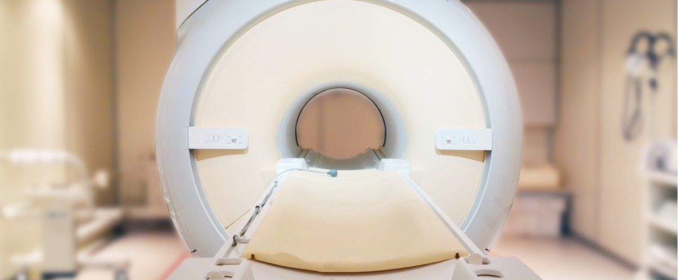
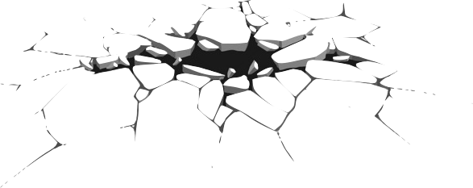
PITFALLS
!
BE AWARE

Slide 33
PITFALLS
MRCP RELATED PITFALLS OR DIAGNOSTIC ERRORS MAY HAVE A VARIETY OF CAUSES AND MAY SIMULATE OR CAMOUFLAGE VARIOUS DISEASES OF THE PANCREATOBILIARY TRACT.
THESE PITFALLS CAN BE CLASSIFIED INTO FOUR MAIN GROUPS:
PITFALLS RELATED TO TECHNIQUE AND RECONSTRUCTION ARTIFACTS
NORMAL VARIANTS MIMICKING PATHOLOGY IN MRCP
PITFALLS RELATED TO INTRA-DUCTAL
FACTORS
PITFALLS RELATED TO EXTRA-DUCTAL
FACTORS
THE AWARENESS OF THE VARIOUS PITFALLS RELATED TO MRCP IS CRUCIAL TO PREVENT MISINTERPRETATION

Slide 34
PITFALLS
RELATED TO TECHNIQUE AND RECONSTRUCTION ARTIFACTS
SMALL FILLING DEFECTS OR STRICTURES CAN BE OBSCURED IN THICK SLAB MRCP AS THE SPATIAL RESOLUTION IS DEGRADED BECAUSE OF VOLUME AVERAGING EFFECTS.
MISSED FILLING DEFECTS AND OVER- OR UNDERESTIMATION OF STRICTURES CAN ALSO BE AFFECTED BY PARTIAL VOLUME EFFECTS THAT DEGRADE SPATIAL RESOLUTION IN MIP REFORMATIONS.
RESPIRATORY MOTION CAN MAKE THE BILIARY TREE SEEM STENOTIC, DILATED, DISCONNECTED OR DUPLICATED ON MIP REFORMATIONS.
IT IS MANDATORY TO REVIEW THE ORIGINAL THIN-SECTION DATA IN ORDER TO AVOID THESE PITFALLS

Slide 35
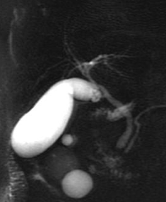

PITFALLS
RELATED TO TECHNIQUE AND RECONSTRUCTION ARTIFACTS
WHERE ARE THE CALCULI?
WHAT ABOUT NOW?
THICK-SLAB 2D MRCP
THIN-SLAB
3D MRCP
RESPIRATORY MOTION ARTIFACTS MAKING IT IMPOSSIBLE TO EVALUATE THIS EXAM
THICK-SLAB CAN OBSCURE SMALL STONES (CIRCLE)
IT IS MANDATORY TO REVIEW THE ORIGINAL THIN-SECTION DATA IN ORDER TO AVOID THESE PITFALLS

Slide 36
PITFALLS
NORMAL VARIANTS MIMICKING PATHOLOGY IN MRCP
A LONG CYSTIC DUCT RUNNING PARALLEL TO THE CBD (RED LINES) MAY SIMULATE A DILATED COMMON DUCT
A CONTRACTED CHOLEDOCHAL SPHINCTER (RED CIRCLES) MAY MIMIC AN IMPACTED STONE OR STRICTURE IN THE DISTAL CBD.
LONG CYSTIC DUCT RUNNING PARALLEL TO CBD
ANALYZING MRCP IN MULTIPLE IMAGING PLANES OR CARRYING OUT REPEAT MRCP IMAGING WILL HELP RESOLVE THESE PROBLEMS. ADDITIONAL MRI SEQUENCES SHOULD ALSO BE EVALUATED

Slide 37
PITFALLS
PITFALLS RELATED TO INTRA-DUCTAL FACTORS
FILLING DEFECTS IN THE BILE TREE MAY BE SEEN ON MRCP NOT ONLY FROM CALCULI BUT ALSO FROM THE PRESENCE OF GAS, DEBRIS, HEMORRHAGE, TUMOR & “FLOW VOID”
PNEUMOBILIA IS SEEN AS A NON-DEPENDENT FILLING DEFECT ON THE AXIAL IMAGES, WHILE A SIGNAL VOID IN THE CENTRAL PART OF THE BILE DUCT IS DUE TO FLOW PHENOMENON AND MAY OCCUR IN DILATED DUCTS AND AT THE POINT OF INSERTION OF A LARGE CYSTIC DUCT
THE PRESENCE OF IODINATED CONTRAST MATERIAL IN THE BILIARY TREE REDUCES BILE’S SIGNAL INTENSITY.
PERFORMING MRCP IN ADDITION TO OTHER MRI SEQUENCES (T1 + T2) AS WELL AS KNOWING THE PATIENT’S CLINICAL / SURGICAL BACKGROUND MAY HELP AVOID THESE PITFALLS

Slide 38





PITFALLS
PITFALLS RELATED TO INTRA-DUCTAL FACTORS
WHAT SHOULD WE THINK ABOUT THIS FILLING DEFECT? (RED ARROWHEADS)
AIR
FLOATS
STONES
SINK
NOTICE THAT ON AXIAL T2WI IT APPEARS AS A NON-DEPENDENT LOW-SIGNAL IMAGE
PNEUMOBILIA
PERFORMING MRCP IN ADDITION TO OTHER MRI SEQUENCES (T1 + T2) AS WELL AS KNOWING THE PATIENT’S CLINICAL / SURGICAL BACKGROUND MAY HELP AVOID THESE PITFALLS

Slide 39



PITFALLS
PITFALLS RELATED TO INTRA-DUCTAL FACTORS
HAVE YOU EVER HEARD OF BILIARY DUCT THROMBUS?
SHOULD THIS BE CONSIDERED A
REAL FILLING DEFECT?
SEQUENCE OF AXIAL ENHANCED T1WI (LEFT) SHOWING HCC WITH INTRA BILE DUCT EXTENSION (BILIARY DUCT TUMORAL THROMBUS – BDTT). 3D-MRCP (RIGHT) SHOWS DUCTAL FILLING DEFECTS SECONDARY TO TUMORAL INVASION.
PSEUDO FILLING DEFECT CAUSED BY FLOW ARTIFACT (“FLOW VOID”)
PERFORMING MRCP IN ADDITION TO OTHER MRI SEQUENCES (T1 + T2) AS WELL AS KNOWING THE PATIENT’S CLINICAL / SURGICAL BACKGROUND MAY HELP AVOID THESE PITFALLS

Slide 40
PITFALLS
PITFALLS RELATED TO EXTRA-DUCTAL FACTORS
PULSATILE VASCULAR COMPRESSION FROM ADJACENT VESSELS MAY MIMIC A BILE DUCT STRICTURE.
THE MOST COMMON SITE OF EXTRINSIC VASCULAR COMPRESSION IS THE COMMON HEPATIC DUCT, FOLLOWED BY THE LEFT HEPATIC DUCT, BOTH DUE TO THE RIGHT HEPATIC ARTERY CROSSING ITS POSTERIOR ASPECT
OVERLAPPING OF THE BILIARY TREE WITH OTHER STATIONARY FLUIDS (I.E. FROM ADJACENT BOWEL, CYSTIC COLLECTIONS, DIVERTICULI OR ASCITES) MAY ALSO CAUSE INTERPRETATION PROBLEMS.
PERFORMING OTHER MRI SEQUENCES (T1 + T2) IN ADDITION TO MRCP AS WELL AS KNOWING THE PATIENT’S CLINICAL / SURGICAL BACKGROUND MAY HELP AVOID THESE PITFALLS

Slide 41


PITFALLS
PITFALLS RELATED TO EXTRA-DUCTAL FACTORS
THE UNAWARE RADIOLOGIST MAY BE FOOLED BY THIS
“FILLING DEFECT” (RED ARROWHEADS)... BUT NOT YOU!
DID YOU REALLY THINK YOU WERE GOING TO BE FREE FROM CHOLECYSTECTOMY METALLIC CLIPS (RED CIRCLES)??
CORONAL T2WI (LEFT) AND 3D-MRCP (RIGHT) SHOWING RIGHT HEPATIC ARTERY INTERPOSING COMMON HEPATIC BILE DUCT SIMULATING FILLING DEFECT
HERE IT IS ONCE AGAIN! MRCP IMAGES (LEFT) SHOW A PSEUDO-STRICTURE TO THE COMMON HEPATIC DUCT, CONFIRMED WITH THE AXIAL T1WI-GRE IMAGE (RIGHT)
PERFORMING OTHER MRI SEQUENCES (T1 + T2) IN ADDITION TO MRCP AS WELL AS KNOWING THE PATIENT’S CLINICAL / SURGICAL BACKGROUND MAY HELP AVOID THESE PITFALLS

Slide 42



PITFALLS
PITFALLS RELATED TO EXTRA-DUCTAL FACTORS
REMEMBER THIS AEROBILIA CASE FROM THE PREVIOUS SLIDE?
OVERLAPPING ASCITES OBSCURES THE BILIARY TREE ON MRCP
DIVERTICULUM
DUODENUM
CBD
WELL, WELL, WELL... THERE IS ALSO A DUODENAL DIVERTICULUM THAT OBSCURES CBD DISTAL ANALYSIS
PERFORMING OTHER MRI SEQUENCES (T1 + T2) IN ADDITION TO MRCP AS WELL AS KNOWING THE PATIENT’S CLINICAL / SURGICAL BACKGROUND MAY HELP AVOID THESE PITFALLS

Slide 43



PITFALLS
PITFALLS RELATED TO EXTRA-DUCTAL FACTORS
LET’S CHECK OUT IF YOU GOT THE DRIFT!
WRONG! CHECK AGAIN!
PANCREATIC CYSTS OBSCURING DUCTAL EVALUATION
“STONES SINK, AIR FLOATS...” SO THESE ARE STONES, RIGHT?! (RED ARROWHEAD)
ALWAYS CHECK MULTIPLE IMAGING PLANES SO YOU WON’T BE FOOLED BY HEPATIC VESSELS MIMICKING CHOLECYSTOLITHIASIS
PERFORMING OTHER MRI SEQUENCES (T1 + T2) IN ADDITION TO MRCP AS WELL AS KNOWING THE PATIENT’S CLINICAL / SURGICAL BACKGROUND MAY HELP AVOID THESE PITFALLS

Slide 44
“PEARLS OF WISDOM”
MRCP SHOULD ALWAYS BE CONSIDERED AS A GREAT NON-INVASIVE METHOD IN THE EVALUATION OF PANCREATOBILIARY DISORDERS, ESPECIALLY WHEN ASSOCIATED WITH ADDITIONAL MRI SEQUENCES, ALLOWING FOR BETTER EXAMINATION OF EXTRADUCTAL LESIONS AS WELL AS ADJACENT STRUCTURES.
WHEN EVALUATING AN MRCP IMAGE, PANCREATOBILIARY ANATOMY AND COMMON ANATOMIC VARIATIONS SHOULD ALWAYS BE IN THE RADIOLOGIST’S MIND.
IN ORDER TO AVOID PITFALLS RELATED TO TECHNIQUE AND RECONSTRUCTION ARTIFACTS, IT IS MANDATORY TO REVIEW THE ORIGINAL THIN-SECTION DATA.
ANALYZING MRCP IN MULTIPLE IMAGING PLANES AND CARRYING OUT REPEAT MRCP IMAGING WILL HELP RESOLVE PITFALLS RELATED TO ANATOMIC VARIATIONS THAT MIMIC DISEASES. ADDITIONAL MRI SEQUENCES SHOULD ALSO BE EVALUATED.
PERFORMING OTHER MRI SEQUENCES (T1 + T2) IN ADDITION TO MRCP, AS WELL AS KNOWING THE PATIENT’S CLINICAL/SURGICAL BACKGROUND, MAY HELP AVOID PITFALLS.

Slide 45
SUGGESTED READING
Griffin N, Charles-Edwards G, and Grant LA. Magnetic Resonance Cholangiopancreatography: the ABC of MRCP. Insights into Imaging 2011;3(1):11–21.
Hintze RE, Adler A, Veltzke W, et al. Clinical significance of magnetic resonance cholangiopancreatography (MRCP) compared to endoscopic retrograde cholangiopancreatography (ERCP). Endoscopy 1997;29:182-187.
Irie H, Honda H, Tajima T, et al. Optimal MR Cholangiopancreatographic Sequence and Its Clinical Application. Radiology 1998;206:379-387.
Mortelé KJ, Rocha TC, Streeter JL, et al. Multimodality Imaging of Pancreatic and Biliary Congenital Anomalies. RadioGraphics 2006;26(3):715–731.
Sureka B, Bansal K, Patidar Y, et al. Magnetic Resonance Cholangiographic Evaluation of Intrahepatic and Extrahepatic Bile Duct Variations. Indian J Radiol Imaging 2016;26:22-32.

Slide 46
ADDITIONAL READING
Aduna M, Larena JA, Martin D, et al. Bile Duct Leaks After Laparoscopic Cholecystectomy: Value of Contrast-Enhanced MRCP. Abdom Imaging 2005;30:480–487.
Hoeffel C, Azizi L, Lewin M, et al. Normal and Pathologic Features of the Postoperative Biliary Tract at 3D MR Cholangiopancreatography and MR Imaging. RadioGraphics 2006;26:1603–1620
Irie H, Honda H, Kuroiwa T, et al. Pitfalls in MR Cholangiopancreatographic Interpretation. RadioGraphics 2001;21(1):23–37.
O’Connor OJ, O’Neil S, Maher, MM. Imaging of Biliary Tract Disease. American Journal of Roentgenology 2011;197(4):W551–W558.
Singh A, Gelrud A, Agarwal B. Biliary Strictures: Diagnostic Considerations and Approach. Gastroenterology Report 2014;3(1):22–31.
Vitellas KM, Keogan MT, Spritzer CE, et al. MR Cholangiopancreatography of Bile and Pancreatic Duct Abnormalities With Emphasis on the Single-Shot Fast Spin-Echo Technique. RadioGraphics 2000;20:939–957.
Watanabe Y, Dohke M, Ishimori T, et al. Diagnostic Pitfalls of MR Cholangiopancreatography in the Evaluation of the Biliary Tract and Gallbladder. RadioGraphics 1999;19(2):415-429.

